Slide 1
171. Excel Sheet Column Number — Leetcode Problem
Write your topic or idea
Excel ka column title base-26 number system jaisa kaam karta hai, jisme:
'A' = 1, 'B' = 2, ..., 'Z' = 26
'AA' = 27, 'AB' = 28, 'AZ' = 52, 'BA' = 53, and so on.
Lekin normal base-26 se thoda alag hai — isme 'A' ka value 1 se start hota hai, zero nahi hota (base-26 mein usually '0' hota hai).
Is problem mein humein ek Excel column title diya gaya hai (jaise "A", "Z", "AA", "AB", "AZ"...), aur humein usse ek number mein convert karna hai.

Slide 2
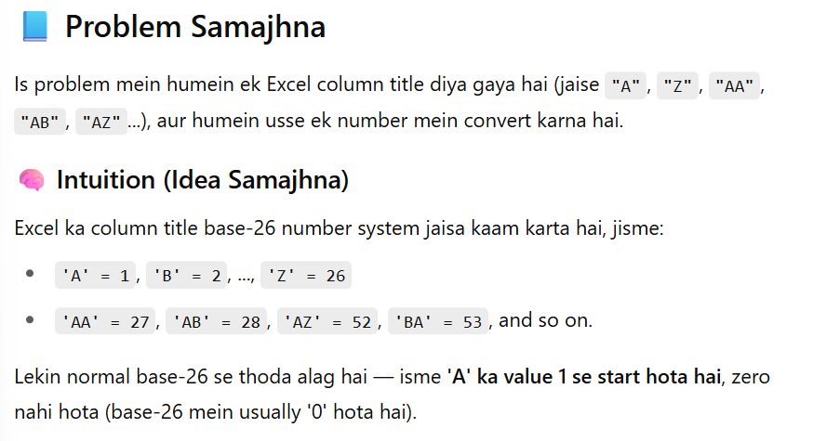

Slide 3
Step by Step
Har character ko number mein convert karo:
'A' ka value hota hai ord('A') - ord('A') + 1 = 1
'B' ka value 2, ..., 'Z' ka value 26.
Result ko har step pe 26 se multiply karo:
Kyuki har character left se right base-26 place value represent karta hai.
Us character ka value add karo:
Ye value running total res mein add karte hain.
Loop ke baad final res return kar dete hain.

Slide 4
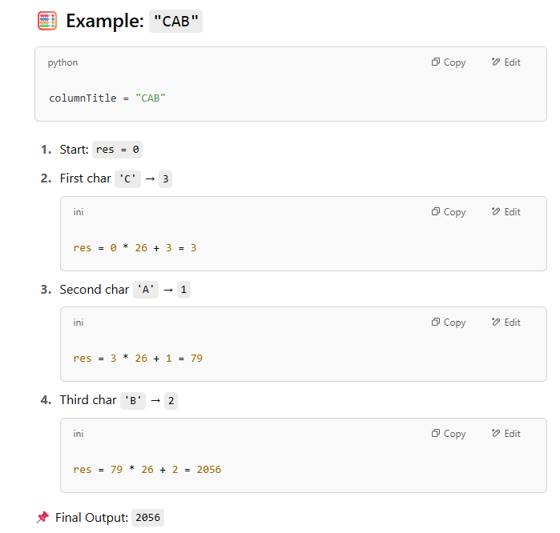

Slide 5
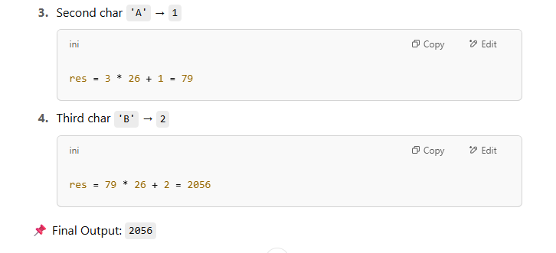

Slide 6
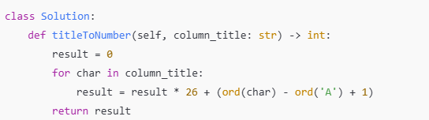
Python Code:

Slide 7
⏱️ Time & Space Complexity
Time Complexity: O(n) → n = length of column title
Space Complexity: O(1) → Sirf ek variable result use hota hai

Slide 8
🧾 Summary in Hinglish
Excel title ko base-26 number system ke jaise treat karna hai
'A' = 1, 'Z' = 26, 'AA' = 27, 'AB' = 28, ...
Har character ka numerical value calculate karo
Result ko 26 se multiply karke naye character ka value add karo
Final result return kar do

